Slide 1
Data Visualization Website
Sadiqul Islam Shafi 2031384642 CSE299 Project Presentation

Slide 2
Table of contents
01
02
03
04
05
06
Introduction
Overview
Market opportunity
Home Page/Features
Conclusion
Demonstration

Slide 3

Introduction
Brief overview of the project
Importance of data visualization in decision making
Objective: To provide an interactive and comprehensive data visualization tool for better insights

Slide 4
Introduction
The Data Visualization Dashboard is designed to offer a comprehensive, interactive, and user-friendly tool for visualizing data. Built with a focus on versatility and ease of use, the dashboard allows users to create a variety of charts, including Line, Bar, and Pie charts, to suit their analytical needs. With features like CSV uploads and advanced analysis capabilities, the tool is equipped to handle both simple and complex data sets, providing meaningful insights at a glance.
In today's data-driven world, the ability to visualize data effectively is crucial for making informed decisions. Data visualization transforms raw data into graphical representations, making it easier to identify trends, patterns, and outliers. This not only enhances understanding but also enables quicker, more accurate decision-making.

Slide 5
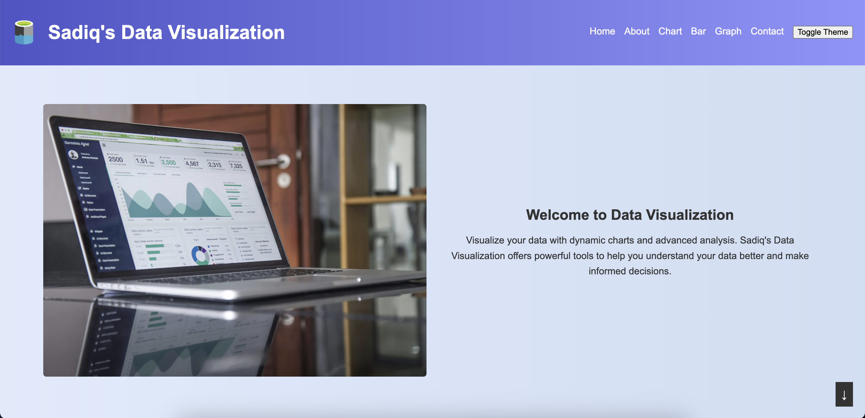

Slide 6
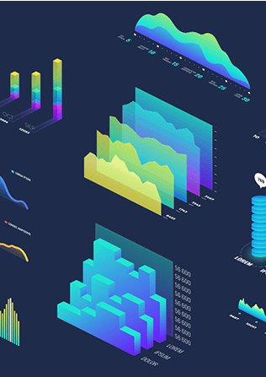
02
Overview

Slide 7
Overview
Comprehensive Visualization Options
Interactive and User-Friendly Interface
Advanced Analysis Capabilities
The Data Visualization Dashboard offers a wide range of visualization options, including Line, Bar, and Pie charts.
The dashboard is built with a focus on user experience, featuring an intuitive interface that simplifies the process of data visualization. Users can easily input their data through text fields or by uploading CSV files.
Users can toggle advanced analysis to view statistical measures such as standard deviation, variance, median, mode, quartiles, skewness, and kurtosis.

Slide 8

03
Market Opportunity

Slide 9
Key ideas in market opportunity
Growing Demand for Data-Driven Decision Making
Support for Remote and Hybrid Work Environments
Expansion into Educational Institutions
Customizable Solutions for Industry-Specific Needs

Slide 10

04
Home Page

Slide 11
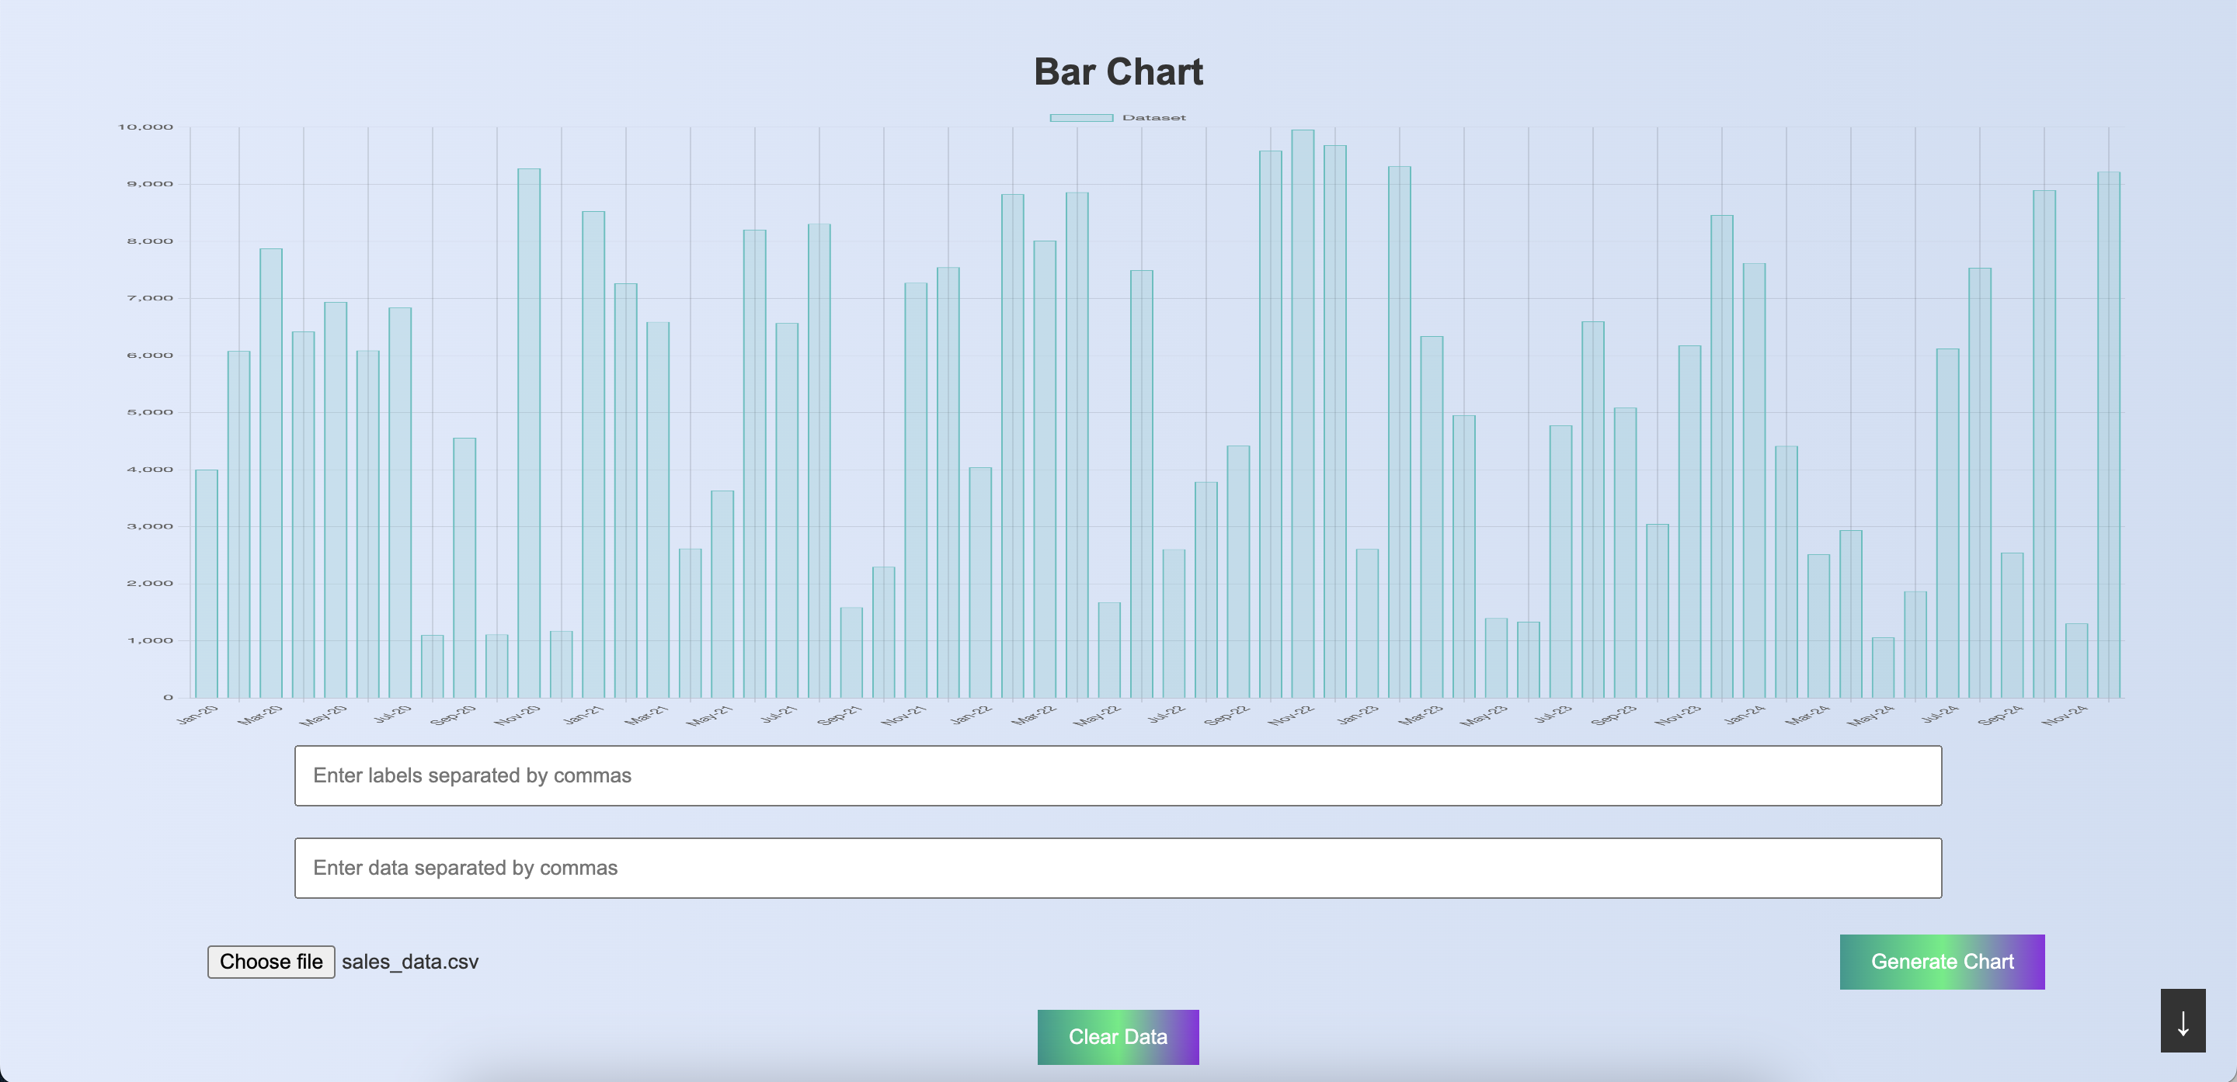

Slide 12
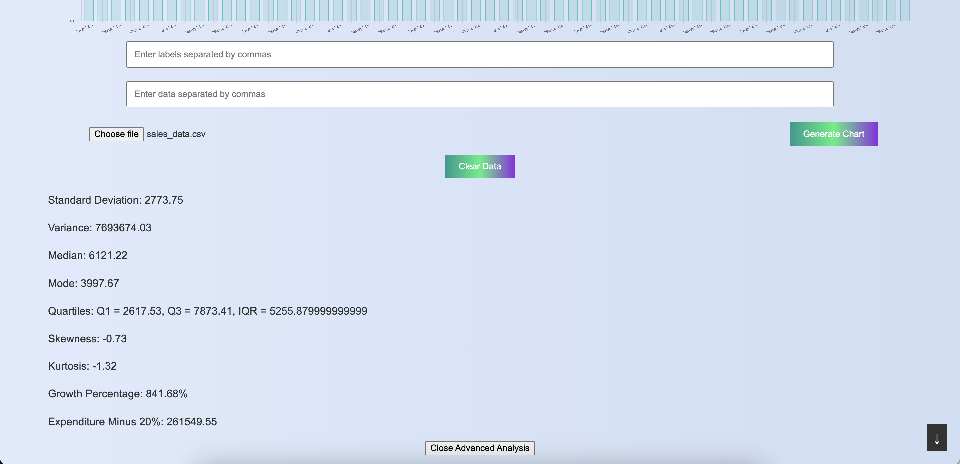

Slide 13
Home Page in 6 Points
Welcome Message
Brief Description of purpose
User-Centric Design
It highlights how the tool transforms raw data into meaningful visualizations, enabling users to gain valuable insights and make informed decisions.
It highlights how the tool transforms raw data into meaningful visualizations, enabling users to gain valuable insights and make informed decisions.
Intuitive layouts and clear navigation options ensure users can easily access the features they need without any confusion or hassle.
Ease of Navigation
Highlight Key Features
Visual Appeal
Users can quickly find the sections they are interested in, whether it's creating charts, analysing data, or exploring advanced features.
This includes options for generating line charts, bar charts, and pie charts, along with tools for both basic and advanced data analysis.
The home page is visually appealing, featuring a modern design with an attractive colour scheme and professional graphics.

Slide 14
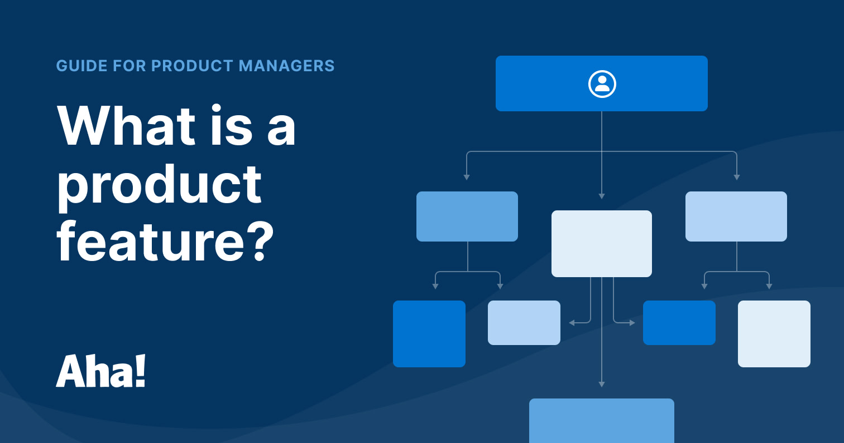
05
Conclusion

Slide 15
Conclusion
In conclusion, this Data Visualization tool enhances decision-making by providing intuitive and interactive visualizations that empower users to make data-driven choices. It was designed with user experience in mind, the dashboard offers clear insights and easy navigation, catering to both basic and advanced analytical needs. The tool addresses the growing demand for accessible data visualization solutions, presenting significant market potential in areas such as business intelligence, education, and healthcare analytics. With ongoing improvements based on user feedback, the dashboard will continue to evolve, incorporating new features to remain at the forefront of data visualization technology.

Slide 16
Demonstration

